Slide 1
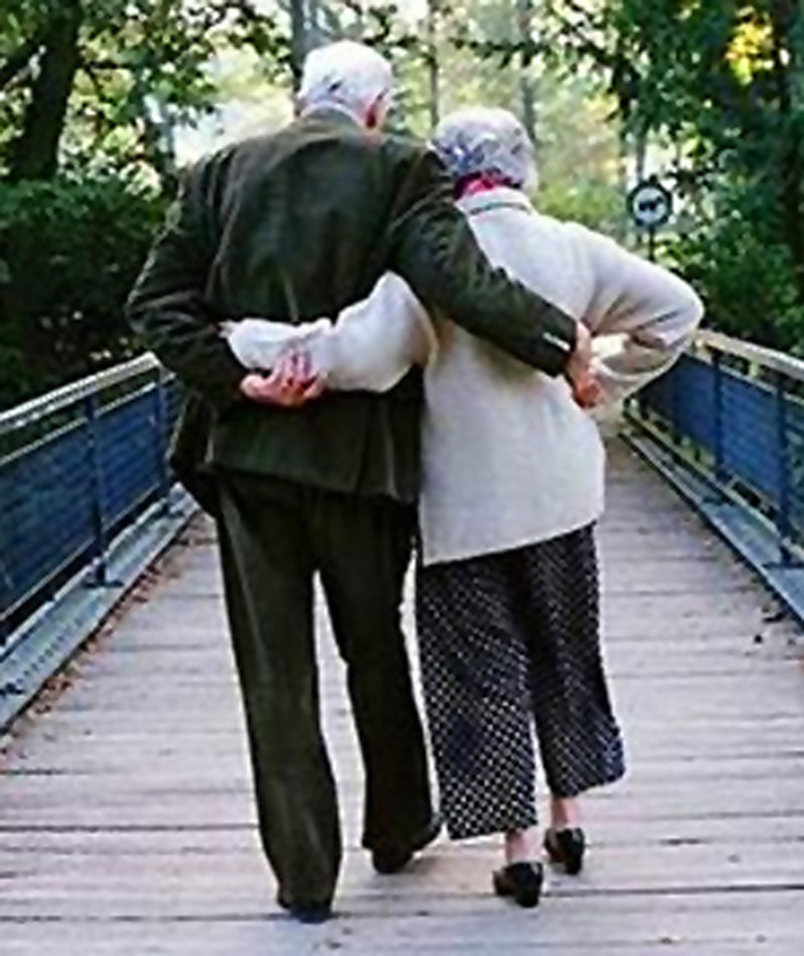
Married: Growing & Serving Together
Resolving Conflict in Marriage
A Study of Marriage, Spring 2023

Slide 2
Communication in Marriage
Review
The Importance of Effective Communication in Marriage
It establishes and builds understanding
It is critical in helping resolve conflict
It builds trust
It enhances emotional intimacy
It strengthens decision making
It contributes to long-term happiness
It strengthens our spiritual lives

Slide 3
Communication in Marriage
Review
Hindrances to Achieving Effective Communication
Poor listening skills
Emotional barriers
Busy schedules and distractions
Unresolved conflict
Poor communication habits

Slide 4
Be Forewarned, There is Conflict in Marriage!
To accomplish anything worthwhile requires working through trials and conflicts.
“As a pastor I have spoken to thousands of couples...I’ve heard them say over and over, “Love shouldn’t be this hard; it should come naturally.” In response, I always say something like, “Why believe that? Would someone who wants to play professional baseball say, ‘It shouldn’t be so hard to hit a fastball?’ Would someone who wants to write the greatest American novel of her generation say, ‘It shouldn’t be hard to create believable characters and compelling narrative?’” The understandable retort is, “But this is not baseball or literature. This is love. Love should just come naturally if two people are compatible, if they are truly soul mates.” The Christian answer to this is that no two people are ‘compatible’.” – Tim Keller, The Meaning of Marriage
“Beloved, do not be surprised at the fiery trial when it comes upon you to test you, as though something strange were happening to you.” – 1 Peter 4:12
“For even when we were with you, we kept telling you in advance that we were going to suffer affliction; and so it happened, as you know.” – 1 Thess. 3:4
“Count it all joy, my brothers, when you meet trials of various kinds, for you know that the testing of your faith produces steadfastness. And let steadfastness have its full effect, that you may be perfect and complete, lacking in nothing.” – Jas. 1:2-3
Notes:
Trials of various kinds are to be expected and can actually be a positive thing.

Slide 5
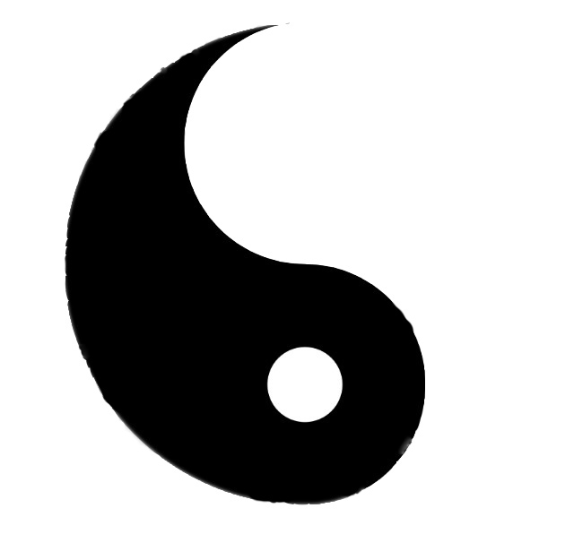
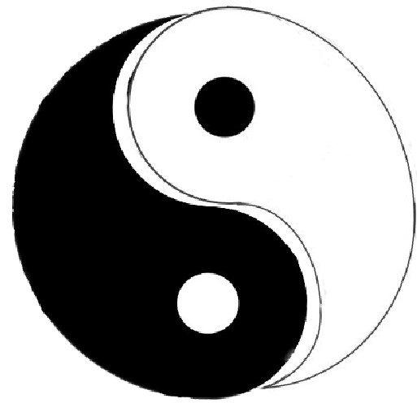
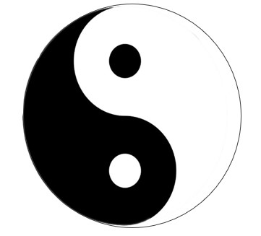
What Should “One Flesh” Look Like?
(Two People Can Exist Together in a Variety of Ways)
Not
Engaged *
Active
Engagement
(Can be productive or unproductive)
One Dominates & One Surrenders *
* No Conflict!
OR

Slide 6
What Should “One Flesh” Look Like?
(Two People Can Exist Together in a Variety of Ways)
The Ideal
(In God’s Image, distinct personalities that are inseparably united, completed by the other)

Slide 7
Genesis 3:11ff Sin Changes Everything
He (God) said, “Who told you that you were naked? Have you eaten of the tree of which I commanded you not to eat?” The man said, “The woman whom you gave to be with me, she gave me fruit of the tree, and I ate.” Then the LORD God said to the woman, “What is this that you have done?” The woman said, “The serpent deceived me, and I ate.”
The LORD God said to the serpent, “Because you have done this, cursed are you ...and dust you shall eat all the days of your life. (v.15) I will put enmity between you and the woman, and between your offspring and her offspring;
He shall bruise your head, and you shall bruise his heel.” (Messianic promise)
(v.16) To the woman he said, “I will surely multiply your pain in childbearing; in pain you shall bring forth children. Your desire shall be contrary to your husband, but he shall rule over you.” (ESV) (Not a loving desire)
However we understand the exact meaning of the curse on the women, some type of tension between the woman and her husband’s rule is being pronounced which previously did not exist. The curse was not the starting point of woman’s subjection, but it would now be more painful because of the sinful tendencies of mankind in this broken world.
or
(v.16) To the woman he said, “I will greatly multiply Your pain in childbirth, In pain you will bring forth children; Yet your desire will be for your husband, And he will rule over you.” (NASB) (Type of desire uncertain)

Slide 8
The Joy and Frustration of Complementary Natures
“Remember, this person is utterly unlike you. He acts differently, thinks differently, and operates differently, and in some cases, dealing with him is not only frustrating and scary, but it’s downright incomprehensible. But at a deeper level, you’re finding out who you really are. You’re seeing him as your other half. You see how God is completing you in your husband. The result of completion is personal ease. Adam and Eve were naked and unashamed with each other before the Fall. There was no anxiety, no hiding. There was a sense of a primordial, ancient unity and accord that Adam and Eve had then that we’ve not experienced since...This is one part of the glory of marriage, in the Biblical conception. Two people of different sexes make the commitment and sacrifice that is involved in embracing the other. It is often painful and always complicated, but it helps us grow and mature in ways no other experience can produce, and it brings about deep unity because of the profound complementarity between the sexes.”
- Kathy Keller, The Meaning of Marriage

Slide 9
We Have Learned Conflict Within a Marriage is Normal
Male and female are “like opposite to” one another; different pieces of a puzzle intended to fit together.
Marriage involves leaving, cleaving, and becoming “one flesh.” This is hard work involving merging two people of different genders, families, experiences, beliefs, and habits.
Since the fall, marriage is not immune to the effects of mankind’s struggle with sin, including selfishness and blaming others.
In a sinful, broken world, power & authority are frequently abused. Thus, the principles of headship & submission in marriage are very unpopular in today’s culture.
Both the abuse of authority and chafing at submission to authority are rooted in the same sin – selfishness.
Ephesians 5 teaches us that when God designed marriage for mankind, he already had the sanctifying work of Jesus in mind.
“God designed marriage to make us holy more than to make us happy.” – Gary Thomas, Sacred Marriage

Slide 10
We Have Learned Conflict Within a Marriage is Normal
The purpose of the marriage relationship parallels the purpose of Christ’s relationship with every believer - to produce deep character change in us - what the Bible calls Sanctification (to make us holy).
“God’s saving love in Christ...is marked by both radical truthfulness about who we are and yet also radical, unconditional commitment to us...The hard times of marriage drive us to experience more of this transforming love of God... real happiness is on the far side of holiness, not the near side.” – Tim Keller, The Meaning of Marriage
Becoming one with our spouse helps us understand our oneness with Christ and vice versa.
Over time, we must constantly work on our relationship to keep the emotional connection of romantic love alive in our marriages.
The Bible teaches that marriage involves both passion and sacrificial commitment to the covenant of marriage.
Viewed properly, sex between spouses is all about giving, not receiving, but there are often differences in“needs.”

Slide 11
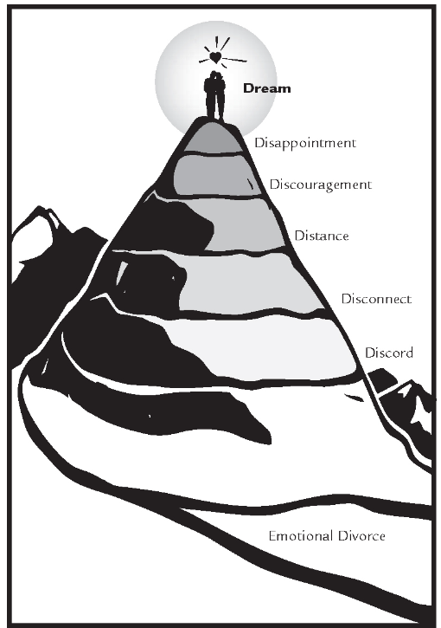
What is Not Normal:
A Continued Downward Spiral!
Dream
Disappointment
Discouragement
from The Marriage Map in “6 Secrets to a Lasting Love: Recapturing Your Dream Marriage” (formerly “Divorce-Proof Your Marriage”) by Gary and Barbara Rosberg
Distance
Disconnect
Discord:
“Conflicts, once suppressed, now surface. There are criticisms, arguments, angry outbursts, and wounds. Bitterness rules the day. It’s like being at war most of the time.”
Divorce (Emotional or Actual)
Notes:
The high divorce rate and hundreds of marriage improvement books attest to the fact that marriage is hard at times. Unfortunately, many marriages spiral downward out of control until it becomes either a persistently unhappy marriage (emotional divorce) or it actually ends in divorce. We need to be on guard to the danger of this downward spiral and develop the skills and determination to reverse this trend.

Slide 12
Strategies for Solving Conflict
- Jeff May and Steve Klein, How to Build Your Dream Home
Loving Communication
Forgiving Love
Serving Love
Achieving Unity
Anger Management
Notes:
May and Klein’s book on marriage and the home dedicates multiple chapters on 5 strategies for solving conflict. We’ll spend most of our remaining time on the first two strategies. They really go together.

Slide 13
A “Crucial Conversation” Has: Three Elements:
Effective Communication is Vital When It’s a “Crucial Conversation”
From Crucial Conversations, Tools for Talking When Stakes are High by Patterson, Grenny, McMillan, and Switzler
Opposing Opinions
Strong Emotions
Crucial Conversations
©VitalSmarts
High Stakes
Notes:
We’re not talking about routine conversations like “What’s for dinner?” or “Where do you want to order take out?” There’s usually little potential for these routine things to turn into a conflict.

Slide 14
Strategies for Solving Conflict
- Jeff May and Steve Klein, How to Build Your Dream Home
Loving Communication – “But speaking the truth in love, we are to grow up in all aspects into Him who is the head, that is, Christ” (Eph. 4:15)” (Ephesians 4:15)
Forgiving Love – Showing grace to each other in view of the gift of God’s forgiving grace to us.
Serving Love
Achieving Unity
Anger Management
Notes:
So, during these “crucial conversations” or “conflicts,” spouses need to be especially careful to practice these first two strategies for solving conflict – loving communication and forgiving love.

Slide 15
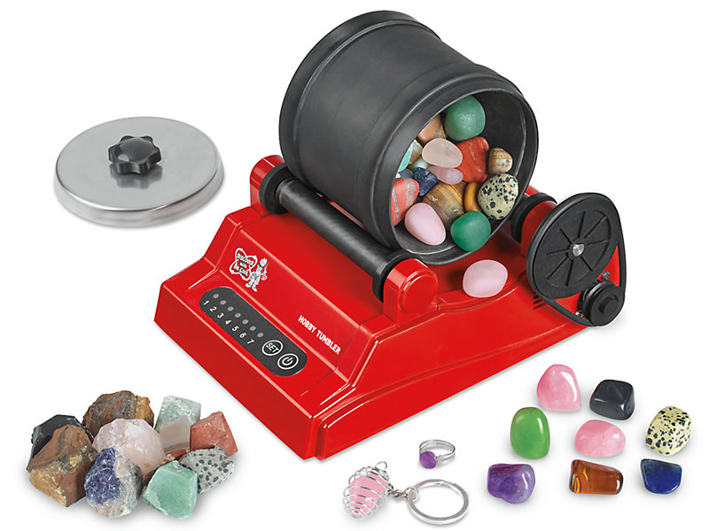
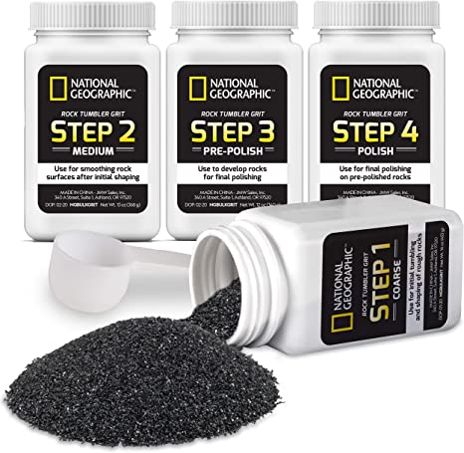
Our Rough Edges Need “Polishing”!
“Marriage is like a gem tumbler. You put gems into the tumbler, and they are brought into constructive, creative contact with each other. They knock the rough edges off of each other until each gem is smooth and beautiful. But if you don’t put a special compound into the tumbler with the gems, the stones will either bounce off of one another without any effects or may crack and shatter each other. The grinding compound in the gem tumbler is like God’s grace in a marriage. Without the power of grace, truth and love can’t be combined. Spouses either stay away from the truth—they bounce off each other—or else they attack one another [w/o love], and they shatter.” - Arvin Engelson
Notes:
Remember this example from an earlier class of a rock tumbler or polisher along with several types of polishing compound. Deep character change (Sanctification) in marriage will require some polishing of each other along the way. In this analogy, “polishing” is a way of describing constructive marital conflict.

Slide 16
Speaking the Truth in Love
“When you first fall in love, you think you love the person, but you don’t really. You can’t know who the person is right away. That takes years. You actually love your idea of the person—and that is always, at first, one-dimensional and somewhat mistaken...But not only do you not know the other person, but the other person does not really know you. You have put on your best face (often quite literally.) There are things about yourself that you are ashamed of or afraid of, but you don’t let the other person see your flaws. And, of course, you cannot show your partner those parts of your character that you cannot see yourself and which will only be revealed to you in the course of the marriage.” – Tim and Kathy Keller, The Meaning of Marriage, 2011
“We never know whom we marry; we just think we do. Or even if we first marry the right person, just give it a while and he or she will change. For marriage, being [the enormous thing it is] means we are not the same person after we have entered it. The primary problem is . . . learning how to love and care for the stranger to whom you find yourself married.” – Stanley Hauerwas, Professor of Ethics, Duke University
Notes:
So, lets talk about the first need in conflicts - Loving Communication or “Speaking the Truth in Love”

Slide 17
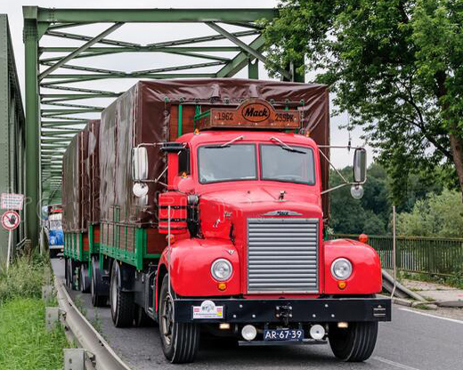
The Power of Truth

Slide 18
The Power of Truth
“Think of an old bridge over a stream. Imagine that there are structural defects in the bridge that are hard to see. There may be hairline fractures that a very close inspection would reveal, but to the naked eye there is nothing wrong. But now see a ten-ton Mack truck drive onto the bridge. What will happen? The pressure from the weight of the truck will open those hairline fractures so they can be seen. The structural defects will be exposed for all to see because of the strain the truck puts on the bridge. Suddenly, you can see where all the flaws are. The truck didn’t create the weaknesses; it revealed them. When you get married, your spouse is a big truck driving right through your heart. Marriage brings out the worst in you. It doesn’t create your weaknesses (though you may blame your spouse for your blow-ups)—it reveals them. This is not a bad thing, though. How can you change into your “glory-self” if you assume that you’re already pretty close to perfect as it is?– Tim and Kathy Keller, The Meaning of Marriage, 2011

Slide 19
The Power of Truth
Marriage brings two people into the closest, most inescapable contact with another person possible.
Spouses can’t help but see each other’s flaws.
“Eventually...our eyes are opened, and we see the warts of the other person. Her endearing “quirks” are now merely annoying. His sharp sense of humor now wounds.” – Gary Chapman, 5 Love Languages
This is good, because the flaws that most enslave us are the ones we ourselves are blind to.
We need to give our spouse the right to hold us accountable – “But encourage one another daily,...so that none of you may be hardened by sin’s deceitfulness.” – Heb. 3:13
The power of speaking the truth to each other in marriage is truly a gift, but it can be a hard gift to receive without the power of love.

Slide 20
Speaking the Truth in Love
“How wonderful that it [marriage] also has the “power of love”—an unmatched power to affirm you and heal you of the deepest wounds and hurts of your life. You come into marriage with a self-image, an assessment of your worth. It is the sign of many verdicts passed upon you over the years by a great variety of people. Parents, siblings, boyfriends and girlfriends, teachers, and coaches have all passed judgments on you - called you good and bad, worthy and unworthy, promising and hopeless...But now into your life comes someone who has the power to overturn all the accumulated verdicts that have ever been passed upon you by others or by you yourself. Marriage puts into your spouse’s hand a massive power to reprogram your own self-appreciation. He or she can overturn anything previously said about you, to a great degree redeeming the past. The love and affirmation of your spouse has the power to heal you of many of the deepest wounds. Why? If all the world says you are ugly, but your spouse says you are beautiful, you feel beautiful. To paraphrase a passage of Scripture, your heart may condemn you, but your spouse’s opinion is greater than your heart.” – Tim Keller, The Meaning of Marriage
“God commands us not only to speak the truth to each other, but to “[speak] the truth in love” (Eph. 4:15), even to people who have wronged or mistreated us (1 Pet. 3:9)” – Ken Sande, The Peacemaker, A Biblical Guided to Resolving Personal Conflict
“Do not repay evil with evil or insult with insult. On the contrary, repay evil with blessing, because to this you were called so that you may inherit a blessing.” - 1 Peter 3:9

Slide 21
Speaking the Truth in Love
Because marriage is the closest possible contact, a positive assessment by our spouse has ultimate credibility. Compliments from a casual acquaintance are not as impactful.
To be highly esteemed by someone you highly esteem is the greatest thing in the world (whether by our spouse or God)!
If we are routinely speaking love to our spouse using their love language, we create a safe zone for discussing anything with them.
We must be careful with our powerful credibility, because criticism of our spouse is as highly impactful as our compliments.
Without love, even criticism that is true does not help – it destroys.
It takes both truth and love together to approach our spouse about a flaw in such a way that they feel the security to admit their fault.
We often fail because we forget how flawed we are as well. That’s when we need to remember God’s grace toward us.
We need the grinding compound of grace in our gem tumbler!

Slide 22
Strategies for Solving Conflict
- Jeff May and Steve Klein, How to Build Your Dream Home
Loving Communication
Forgiving Love (Grace)
“A happy marriage is the union of two good forgivers” - Robert Quillen (1887 – 1948)
Our Pattern for Forgiveness – As God has Forgiven Us:
“Forgive us our debts, as we also have forgiven our debtors..” (Matt. 6:12).
“Be kind to one another, compassionate, forgiving each other, just as God in Christ also has forgiven you.” (Eph. 4:32).
“Bearing with one another and, if one has a complaint against another, forgiving each other; as the Lord has forgiven you, so you also must forgive.” (Col. 3:13).
Notes:
Closely related to the first need is our second need in times of conflict – forgiving love or grace.

Slide 23
Forgiveness is NOT:
Excusing something as “OK” (When we excuse, we don’t need to forgive; we forgive people when they are to blame for things that are not “OK.”)
Tolerating (Tolerance & patience are necessary, but they are not the same as forgiveness.
Accepting (Acceptance is needed, but forgiveness is more. It assumes someone has been wronged or mistreated.)
Glossing over an offense without resolution / pretending nothing happened
An emotion or feeling (It is an act of the will regardless of how we feel.)
Forgetting (Forgetting is a passive process that takes time, forgiveness is an active, deliberate choice not to dwell on or talk about the wrong we have suffered.)
A release from consequences (See God’s forgiveness of Moses, David, etc.)
Two keys to forgiveness: Self-awareness and Humility
Notes:
Glossing - There are a lot of minor differences of opinion or misunderstandings that can and should be excused, tolerated, or accepted in a marriage. But, when your spouse is hurt by something you’ve done or said, don’t gloss over it. Don’t ask them to “just drop it.” When we have caused hurt, we should humbly accept blame, sincerely say “I’m sorry” and ask to be forgiven.
Granting forgiveness is not always easy for the one who has been wronged; it requires a deliberate commitment to forgive even when our natural emotions would otherwise reject reconciliation.

Slide 24
What Does It Mean to Forgive?
To release someone from punishment or penalty for a wrong committed.
In the N.T., “Forgive” is most commonly a translation of the Greek “Aphiemi,” meaning to let go, send away, release, or remit. It often refers to debts that have been cancelled or paid in full.
Most other N.T. occurrences of “Forgive” translate the Greek “Charizomai,” meaning to extend grace (“Charis’), bestow favor, or freely give.
Thus, forgiveness is an undeserved gift and cannot be earned.
Forgiveness can be costly; the guilty party has a debt that someone must pay.
When we sin, most of our debt is owed to God. He forgives us by grace through faith in Jesus, but the cost was Jesus’ sacrificial death on the cross.
When our spouse sins against us, part of their debt is owed to us.
Without forgiving, we can extract “payments” on that debt by ill treatment, hurtful words, or other actions of revenge. This may give a sort of perverted pleasure at first, but we hurt ourselves in the long run.
“Unforgiveness is the poison we drink hoping others will die.” – Augustine
Instead, we can make “payments” ourself on the debt, releasing them from the penalty they deserve to pay. This may be easy, but is often hard.
When there has been deep wrong, may need multiple payments over time.
Forgiveness Requires Making & Keeping Promises:
“Through forgiveness, God tears down the walls that our sins have built, and He opens the way for a renewed relationship with Him. This is exactly what we must do if we are to forgive as the Lord forgives us: We must release the person who has wronged us from the penalty of being separated from us. We must not hold wrongs against others, not think about the wrongs, and not punish others for them. Therefore, forgiveness may be described as a decision to make four promises:
“I will not dwell on this incident.”
“I will not bring up this incident again and use it against you.”
“ I will not talk to others about this incident.”
“I will not let this incident stand between us or hinder our personal relationship.”
By making and keeping these promises, you can tear down the walls that stand between you and the offender...Summarized in a little poem:
Good thought, Hurt you not. Gossip never, Friends forever.”
– Ken Sande, The Peacemaker, A Biblical Guide to Resolving Personal Conflict
Forgiveness is Not Always Easy:
“Sometimes...you decide to forgive, and by God’s grace the debt is quickly and fully cancelled in your heart and mind. But when there has been a deep wrong, the debt it creates is not always paid at once. You may need to bear certain effects of the other person’s sin over a long period of time. This may involve fighting against painful memories, speaking gracious words when you really want to say something hurtful, working to tear down walls and be vulnerable when you still feel little trust, or even enduring the consequences of material or physical injury that the other person is unable or unwilling to repair. Forgiveness can be extremely costly, but if you believe in Jesus, you have more than enough to make these payments...As you draw on that grace through faith day by day, you will find that you have all that you need to make the payments of forgiveness for those who have wronged you.” – Ken Sande, The Peacemaker, A Biblical Guide to Resolving Personal Conflict
-
Good thought
Hurt you not
Gossip never
Friends forever
Notes:
Aphie’mi (af-ee’-ay-mee)
Charizomai (khar-id’-zom-eye)

Slide 25
Strategies for Solving Conflict
- Jeff May and Steve Klein, How to Build Your Dream Home
Loving Communication
Forgiving Love
Serving Love
- It’s Not About You !
“For where jealousy and selfish ambition exist, there will be disorder and every vile practice. But the wisdom from above is first pure, then peaceable, gentle, open to reason, full of mercy and good fruits, impartial and sincere. And a harvest of righteousness is sown in peace by those who make peace. What causes quarrels and what causes fights among you? Is it not this, that your passions are at war within you? “ – James 3:16-4:1

Slide 26
How Jesus Modelled “Serving Love” as Both Head & Servant
Philippians 2:
5 Have this mind among yourselves, which is yours in Christ Jesus, 6 who, though he was in the form of God, did not count equality with God a thing to be grasped, 7 but emptied himself, by taking the form of a servant, being born in the likeness of men. 8 And being found in human form, he humbled himself by becoming obedient to the point of death, even death on a cross. 9 Therefore God has highly exalted him and bestowed on him the name that is above every name, 10 so that at the name of Jesus every knee should bow, in heaven and on earth and under the earth, 11 and every tongue confess that Jesus Christ is Lord, to the glory of God the Father.
Jesus demonstrated both sacrificial headship over His body (the church), but also sacrificial submission to God

Slide 27
Strategies for Solving Conflict
- Jeff May and Steve Klein, How to Build Your Dream Home
“A happy marriage is the union of two good forgivers” (Robert Quillen).
Loving Communication
Forgiving Love
Serving Love
Achieving Unity
- Become One Flesh!

Slide 28
Strategies for Solving Conflict
- Jeff May and Steve Klein, How to Build Your Dream Home
“A happy marriage is the union of two good forgivers” (Robert Quillen).
Loving Communication
Forgiving Love
Serving Love
Achieving Unity
Anger Management

Slide 29
Anger Management
Anger isn’t always wrong. “Be angry and sin not” (Eph. 4:26a)
God and Jesus demonstrate righteous anger that is neither selfish nor impure.
God is “slow to anger” and His divine wrath is always just.
Man’s anger is usually not so unselfish and pure and often gets out of control.
Anger within marriage usually indicates unmet needs or underlying relationship or personal problems that need to me addressed.
Anger can be compared to the smoke from a hidden fire. The smoke can be harmful itself, but it also alerts us to a fire that needs to be discovered and put out.
“In a healthy relationship, both partners are like smoke detectors... Unresolved or mismanaged anger gives a place to the devil in your home (Eph. 4:26-27).” - Jeff May and Steve Klein, How to Build Your Dream Home
We must learn how to manage anger constructively.

Slide 31
Bonus Material
How to Handle “Crucial Conversations” -
From Crucial Conversations, Tools for Talking When Stakes are High by Patterson, Grenny, McMillan, and Switzler
and
Tips for “Speaking the Truth in Love” -
From The Peacemaker, A Biblical Guide to Resolving Personal Conflict by Ken Sande

Slide 32
What's A Crucial Conversation? Three Elements:
Opposing Opinions
Strong Emotions
Crucial Conversations
High Stakes
© VitalSmarts

Slide 33
Examples of Crucial Conversations at Work
Personality conflicts with employees
Speaking up when a procedure, policy, or request is questionable or unclear
Talking to a coworker who behaves offensively or makes suggestive comments
Giving the boss feedback about his/her behavior

Slide 34
Examples of Crucial Conversations in the Bible
Queen Esther Before the King of Persia
Eli and His Sons
Aquila and Priscilla with Apollos
David and Adonijah
Paul and Philemon
To Teach, Warn, Correct, Confess, Exhort, Encourage, and Edify

Slide 35
Three Options When Faced with a Crucial Conversation:
Avoid it
Face it and deal with it badly
Face it and deal with it well

Slide 36
The "Audacious Claim":
If you're stuck in some aspect of your life, there's a “crucial conversation” you're not holding or not holding well which is keeping you there.

Slide 37
Crucial Conversations
Four (Biblical) Principles That Will Help
Start with Heart: Stay focused on what you REALLY want.

Slide 38
Start With Heart
Focusing on What You Really Want
Proverbs 4:23. ”Watch over your heart with all diligence, For from it flow the springs of life.”
Matthew 12:34-35. "You brood of vipers, how can you, being evil, speak what is good? For the mouth speaks out of that which fills the heart. The good man brings out of his good treasure what is good; and the evil man brings out of his evil treasure what is evil.”

Slide 39
Start With Heart
Work on “ME” First
Stay Focused on the Right Motives
Not: Being Right, Saving Face, Winning, Punishing, or Avoiding Conflict
It Should Be: To Learn, Strengthen Relationships, and Produce Results (Edify)
What Do I Really Want for Me, Others, and This Relationship?

Slide 40
Crucial Conversations
Four (Biblical) Principles That Will Help
Start with Heart: Stay focused on what you REALLY want.
Learn to Look: Notice when safety is at risk.

Slide 41
Learn to Look
Noticing When Safety is at Risk
Proverbs 15:28. ”The heart of the righteous ponders how to answer, But the mouth of the wicked pours out evil things.”

Slide 42
Learn to Look
Look for Signs that a Conversation is Turning “Critical” (Safety at Risk)
In Others
In Yourself
Signs can be emotional, physical, or behavioral
Safety Can Be at Risk Due to:
Silence (Withdrawing, Avoiding, Masking)
“Violence” (Controlling, Labeling, Attacking)
Pay Attention to Content and Conditions

Slide 43
Crucial Conversations
Four (Biblical) Principles That Will Help
Start with Heart: Stay focused on what you REALLY want.
Learn to Look: Notice when safety is at risk.
Make it Safe: If you make it safe, you can talk about almost anything.

Slide 44
Make it Safe
Can I Talk About Almost Anything?
Genesis 13:8. ”So, Abram said to Lot, "Please let there be no strife between you and me, nor between my herdsmen and your herdsmen, for we are brothers.”

Slide 45
Make it Safe
How Can I Talk About Almost Anything?
Mutual Purpose
The reason to talk in the first place
You must know that I care about your goals
We are brothers!
Mutual Respect
Why we continue talking
You must know that I care about you as a person
Count others better than self! (Phil 2:3)

Slide 46
Crucial Conversations
Four (Biblical) Principles That Will Help
Start with Heart: Stay focused on what you REALLY want.
Learn to Look: Notice when safety is at risk.
Make it Safe: If you make it safe, you can talk about almost anything.
Master My Stories: Watch out for clever stories we tell ourselves. Take charge of our emotions.

Slide 47
Master My Stories
Take Charge of My Emotions
Proverbs 16:32. ”He who is slow to anger is better than the mighty, And he who rules his spirit, than he who captures a city.”

Slide 48
Master My Stories Roots of an Emotion
See & Hear
Feel Emotion
Act

Slide 49
Master My Stories Roots of an Emotion
See & Hear
Tell a Story
Feel Emotion
Act
Usually happens subconsciously

Slide 50
Master My Stories
The Problem:
You're in silence or violence and you fell totally justified in staying there
The Solution
Separate Facts from Stories
Watch for Three Clever Stories
Tell the Rest of the Story

Slide 51
Separate Facts from Stories
Facts are visible and audible. They're scientifically verifiable. Facts include behaviors ("You walked in the door at 9:15 A.M.") or other verifiable information ("There is a calculator in your pocket").
Stories are judgments, conclusions, and attributions that we make from the facts. Judgments determine whether facts are good or bad ("You didn't care about being on time and that was inconsiderate"). Conclusions help us fit elements together ("You're carrying a calculator so you must be an engineer"). Attributions tell us why people do what they do ("You enjoy making me late because you know it bugs me to death").

Slide 52
Watch for Three Clever Stories
Victim – I'm an innocent bystander. I played no role in the problem. Woe is me.
Villain – Other people are bad and wrong. They do what they do because they actually take pleasure in it. They enjoy seeing me suffer.
Helpless – There's nothing I can do to make things better.
These are clever because they serve one purpose: to help us justify our own unhealthy actions.

Slide 53
Tell the Rest of the Story
Turn myself from a victim into an actor. "Am I pretending not to notice my role in the situation?"
Turn others from villains into humans. "Why would a reasonable, rational, and decent person do this?"
Turn myself from helpless into able. "What is the right thing to do right now to move toward what I really want?"

Slide 54
Master My Stories
Take Charge of My Emotions
Emotions Don’t Just Happen
You and Only You Create Your Emotions
You Have Only Two Options:
Find a way to master them, or
Fall hostage to them

Slide 55
Crucial Conversations
Four (Biblical) Principles That Will Help
Start with Heart: Stay focused on what you REALLY want.
Learn to Look: Notice when safety is at risk.
Make it Safe: If you make it safe, you can talk about almost anything.
Master My Stories: Watch out for clever stories we tell ourselves. Take charge of our emotions.

Slide 56
Tips for Speaking the Truth in Love
(Ken Sande)
Bring Hope through the Gospel (foundational)
Be Quick to Listen (listening skills)
Waiting
Attending
Clarifying
Reflecting
Agreeing

Slide 57
Tips for Speaking the Truth in Love
The Tongue of the Wise Brings Healing -Proverbs 12:18 (speaking in a clear, constructive, and persuasive manner)
Breathe Grace
Make Charitable Judgments
Speak the Truth in Love
Talk from Beside Not from Above
Help Others Examine the Desires of Their Hearts
Choose the Right Time and Place
Talk in Person Whenever Possible
Engage Rather Than Declare
Communicate So Clearly That You Cannot Be Misunderstood
Plan Your Words
Use “I” Statements
Be Objective
Use the Bible Carefully
Ask for Feedback
Offer Solutions and Preferences
Recognize Your Limits

